Slide 1

CLASS 8 CD-404 DATA SECURITY ISSUES UNIT I
CLOUD COMPUTING SECURITY
Prof. Vineeta Shrivastava
Assistant Professor
Department of Computer Science & Engineering
LNCT-E, Bhopal
Lakshmi Narain College of Technology Excellence, Bhopal

Slide 2
CLASS 8 CD-404 DATA SECURITY ISSUES UNIT I
AGENDA
Cloud Computing
Data Science with Cloud
Google Cloud Platforms
Amazon Web Services
Microsoft Azure Cloud
Social Media Analytics on Cloud
Prof. Vineeta Shrivastava
Assistant Professor
Department of Computer Science & Engineering
LNCT-E, Bhopal
Lakshmi Narain College of Technology Excellence, Bhopal

Slide 3
CLASS 8 CD-404 DATA SECURITY ISSUES UNIT I
Cloud Computing Data Security Issues (how cloud computing and data science are related)
What is Cloud ?
Cloud computing is the on-demand availability of computer system,resource,especially:
Data storage
Computing power
RAM
Internet Connectivity
Without direct active management by the user
Prof. Vineeta Shrivastava
Assistant Professor
Department of Computer Science & Engineering
LNCT-E, Bhopal
Lakshmi Narain College of Technology Excellence, Bhopal

Slide 4
CLASS 8 CD-404 DATA SECURITY ISSUES UNIT I
Types of Cloud
Large clouds often have functions distributed over multiple locations, each location being a data centre:
Private Cloud
Public Cloud
Hybrid Cloud
Prof. Vineeta Shrivastava
Assistant Professor
Department of Computer Science & Engineering
LNCT-E, Bhopal
Lakshmi Narain College of Technology Excellence, Bhopal

Slide 5
CLASS 8 CD-404 DATA SECURITY ISSUES UNIT I
Cloud Services Models:
Clouds operators often have functions distributed over world:
SaaS-Software as a Service
DaaS-Data as a Service
PaaS- Platform as a Service
IaaS-Infrastructure as a Service
Prof. Vineeta Shrivastava
Assistant Professor
Department of Computer Science & Engineering
LNCT-E, Bhopal
Lakshmi Narain College of Technology Excellence, Bhopal

Slide 6
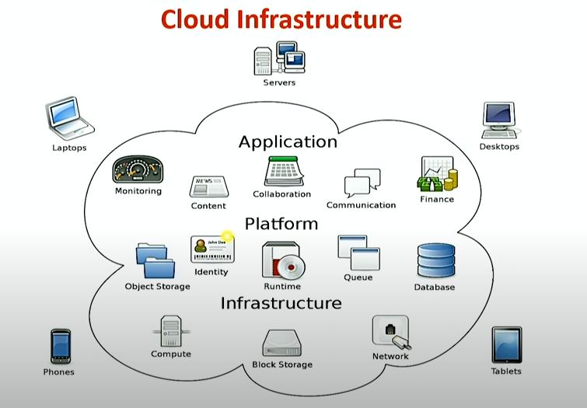
CLASS 8 CD-404 DATA SECURITY ISSUES UNIT I
Cloud Infrastructure
Prof. Vineeta Shrivastava
Assistant Professor
Department of Computer Science & Engineering
LNCT-E, Bhopal
Lakshmi Narain College of Technology Excellence, Bhopal

Slide 7
CLASS 8 CD-404 DATA SECURITY ISSUES UNIT I
How Cloud Computing and Data Science are correlated and how much dependency they have?
Data Science with Cloud
Data Science and cloud computing essentially go hand in hand.
A data Scientist typically analyses different types of data that are stored in the cloud.
Prof. Vineeta Shrivastava
Assistant Professor
Department of Computer Science & Engineering
LNCT-E, Bhopal
Lakshmi Narain College of Technology Excellence, Bhopal

Slide 8
CLASS 8 CD-404 DATA SECURITY ISSUES UNIT I
Why Its Important?
Analysis and storage are the two important challenges for organizations large and small.
Amount of big data generated has accelerated tremendously.
Storage data in cloud is:
Economical
Secure
Prof. Vineeta Shrivastava
Assistant Professor
Department of Computer Science & Engineering
LNCT-E, Bhopal
Lakshmi Narain College of Technology Excellence, Bhopal

Slide 9
CLASS 8 CD-404 DATA SECURITY ISSUES UNIT I
Cloud Computing Benefits for data Scientist:
Use platforms for free or at a minimal price
Choice of available tools:
Open Sources (Hadoop,Python,MySQL)
Commercial (Oracle,MS SQL,SAS,Tableau)
Prof. Vineeta Shrivastava
Assistant Professor
Department of Computer Science & Engineering
LNCT-E, Bhopal
Lakshmi Narain College of Technology Excellence, Bhopal

Slide 10
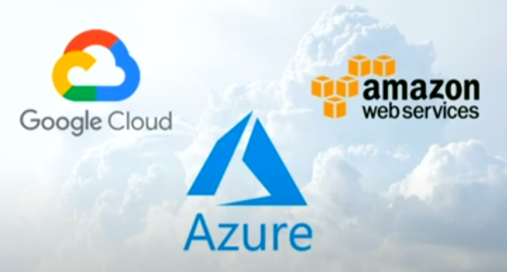
CLASS 8 CD-404 DATA SECURITY ISSUES UNIT I
Examples of Cloud Services
Prof. Vineeta Shrivastava
Assistant Professor
Department of Computer Science & Engineering
LNCT-E, Bhopal
Lakshmi Narain College of Technology Excellence, Bhopal

Slide 11
CLASS 8 CD-404 DATA SECURITY ISSUES UNIT I
Data Science with Cloud: Google Cloud Platforms
Prof. Vineeta Shrivastava
Assistant Professor
Department of Computer Science & Engineering
LNCT-E, Bhopal
Lakshmi Narain College of Technology Excellence, Bhopal

Slide 12
CLASS 8 CD-404 DATA SECURITY ISSUES UNIT I
What is Google Cloud?
Google Cloud Platform ,is a suit of cloud computing services running on the same infrastructure used internally for its end-user products:
Google Search
Gmail
Google Drive
YouTube
Google Translate
Prof. Vineeta Shrivastava
Assistant Professor
Department of Computer Science & Engineering
LNCT-E, Bhopal
Lakshmi Narain College of Technology Excellence, Bhopal

Slide 13
CLASS 8 CD-404 DATA SECURITY ISSUES UNIT I
Google Cloud Benefits:
High Productivity & Innovative
Easy Adoptability
Remote access
Security
Flexibility & Control
Allows to Store & Compute Data
Manage SDLC
API’s Available
Prof. Vineeta Shrivastava
Assistant Professor
Department of Computer Science & Engineering
LNCT-E, Bhopal
Lakshmi Narain College of Technology Excellence, Bhopal

Slide 14
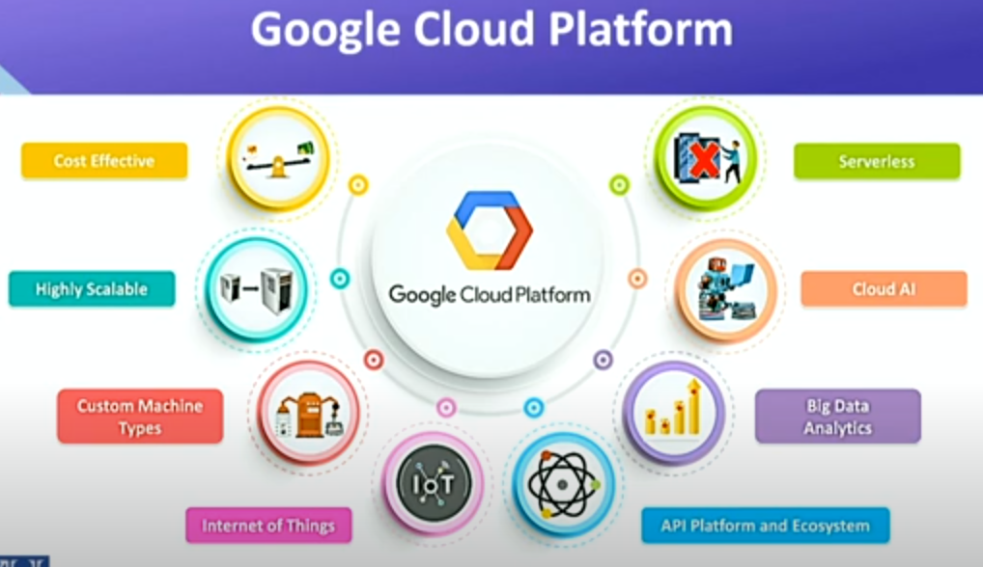
CLASS 8 CD-404 DATA SECURITY ISSUES UNIT I
Google Cloud Platform
Prof. Vineeta Shrivastava
Assistant Professor
Department of Computer Science & Engineering
LNCT-E, Bhopal
Lakshmi Narain College of Technology Excellence, Bhopal

Slide 15
CLASS 8 CD-404 DATA SECURITY ISSUES UNIT I
Data Science with Cloud: Amazon Web Services
Prof. Vineeta Shrivastava
Assistant Professor
Department of Computer Science & Engineering
LNCT-E, Bhopal
Lakshmi Narain College of Technology Excellence, Bhopal

Slide 16
CLASS 8 CD-404 DATA SECURITY ISSUES UNIT I
What is AWS Cloud Platform ?
Amazon Web Services,provides on demand cloud computing platforms and APIs to individuals, companies, and governments on a metered pay-as-you-go basis:
100+Products
Free Trials + Totally Free
Compute,Storage,Databases
Management Console
Machine learning
Prof. Vineeta Shrivastava
Assistant Professor
Department of Computer Science & Engineering
LNCT-E, Bhopal
Lakshmi Narain College of Technology Excellence, Bhopal

Slide 17
CLASS 8 CD-404 DATA SECURITY ISSUES UNIT I
AWS Cloud Platform Benefits:
Amazon Web Services, is the primary profit driver for Amazon. It provides:
Servers
Storage
Security
Networking
Remote Computing
Mobile Development
Prof. Vineeta Shrivastava
Assistant Professor
Department of Computer Science & Engineering
LNCT-E, Bhopal
Lakshmi Narain College of Technology Excellence, Bhopal

Slide 18
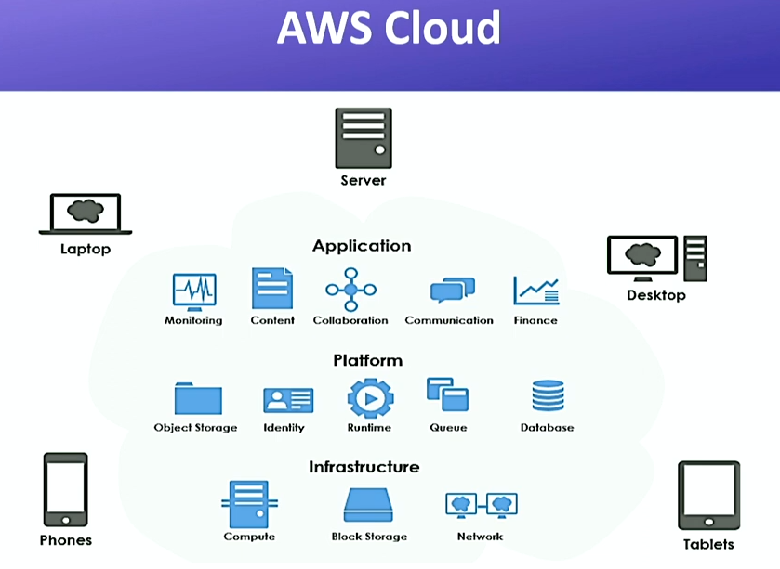
CLASS 8 CD-404 DATA SECURITY ISSUES UNIT I
AWS Cloud
Prof. Vineeta Shrivastava
Assistant Professor
Department of Computer Science & Engineering
LNCT-E, Bhopal
Lakshmi Narain College of Technology Excellence, Bhopal

Slide 19
CLASS 8 CD-404 DATA SECURITY ISSUES UNIT I
Data Science with Cloud: Microsoft Azure Cloud
Prof. Vineeta Shrivastava
Assistant Professor
Department of Computer Science & Engineering
LNCT-E, Bhopal
Lakshmi Narain College of Technology Excellence, Bhopal

Slide 20
CLASS 8 CD-404 DATA SECURITY ISSUES UNIT I
What is MS Azure Cloud Platform ?
The azure application service platform runs logical,mobile,API and business applications and automatically manages the resources required by these applications:
200+Products
Free Account
Hybrid + Multi Cloud
Break, Prepare & Optimize
Compute, Containers ,Networking
Prof. Vineeta Shrivastava
Assistant Professor
Department of Computer Science & Engineering
LNCT-E, Bhopal
Lakshmi Narain College of Technology Excellence, Bhopal

Slide 21
CLASS 8 CD-404 DATA SECURITY ISSUES UNIT I
MS Azure Cloud Platform Benefits:
Cost Optimization
Unmatched Speed of Services
Global Scale Digital Workplace
Productivity & Performance
Flexibility, Reliability & Security
CICD pipelines(DevOps)
Disaster Recovery,Bussiness Continuity
Analytics
Azure APIs and Workflows
Prof. Vineeta Shrivastava
Assistant Professor
Department of Computer Science & Engineering
LNCT-E, Bhopal
Lakshmi Narain College of Technology Excellence, Bhopal

Slide 22
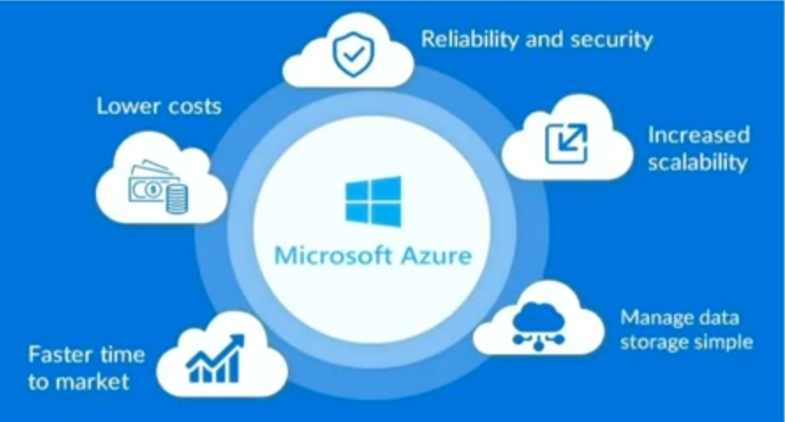
CLASS 8 CD-404 DATA SECURITY ISSUES UNIT I
Microsoft Azure
Prof. Vineeta Shrivastava
Assistant Professor
Department of Computer Science & Engineering
LNCT-E, Bhopal
Lakshmi Narain College of Technology Excellence, Bhopal

Slide 23
CLASS 8 CD-404 DATA SECURITY ISSUES UNIT I
Data Science with Cloud: Social Media Analytics on Cloud
Prof. Vineeta Shrivastava
Assistant Professor
Department of Computer Science & Engineering
LNCT-E, Bhopal
Lakshmi Narain College of Technology Excellence, Bhopal

Slide 24
CLASS 8 CD-404 DATA SECURITY ISSUES UNIT I
Social Media Analytics on Cloud
SMAC is an ecosystem enabling business transformation from e-business to digital and improve business operations and with minimal overhead and maximum reach:
Social Media
Mobile Applications
Data Analysis
Cloud Computing
Prof. Vineeta Shrivastava
Assistant Professor
Department of Computer Science & Engineering
LNCT-E, Bhopal
Lakshmi Narain College of Technology Excellence, Bhopal

Slide 25
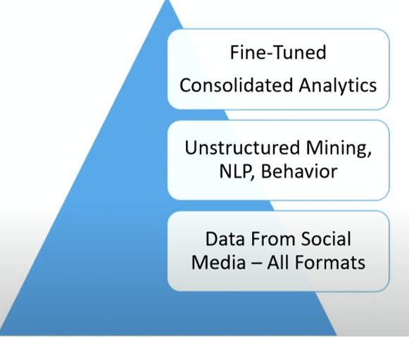
CLASS 8 CD-404 DATA SECURITY ISSUES UNIT I
Social Media Analytics on Cloud Offers the following benefits:
Integrated Data Storage
Cost Effective
Robust & Fast Computations
Multi Tasking
Statistical Modelling
AI/ML Algorithms
Actionable Insights
Prof. Vineeta Shrivastava
Assistant Professor
Department of Computer Science & Engineering
LNCT-E, Bhopal
Lakshmi Narain College of Technology Excellence, Bhopal

Slide 26
CLASS 8 CD-404 DATA SECURITY ISSUES UNIT I
THANKYOU
Prof. Vineeta Shrivastava
Assistant Professor
Department of Computer Science & Engineering
LNCT-E, Bhopal
Lakshmi Narain College of Technology Excellence, Bhopal

